Slide 1
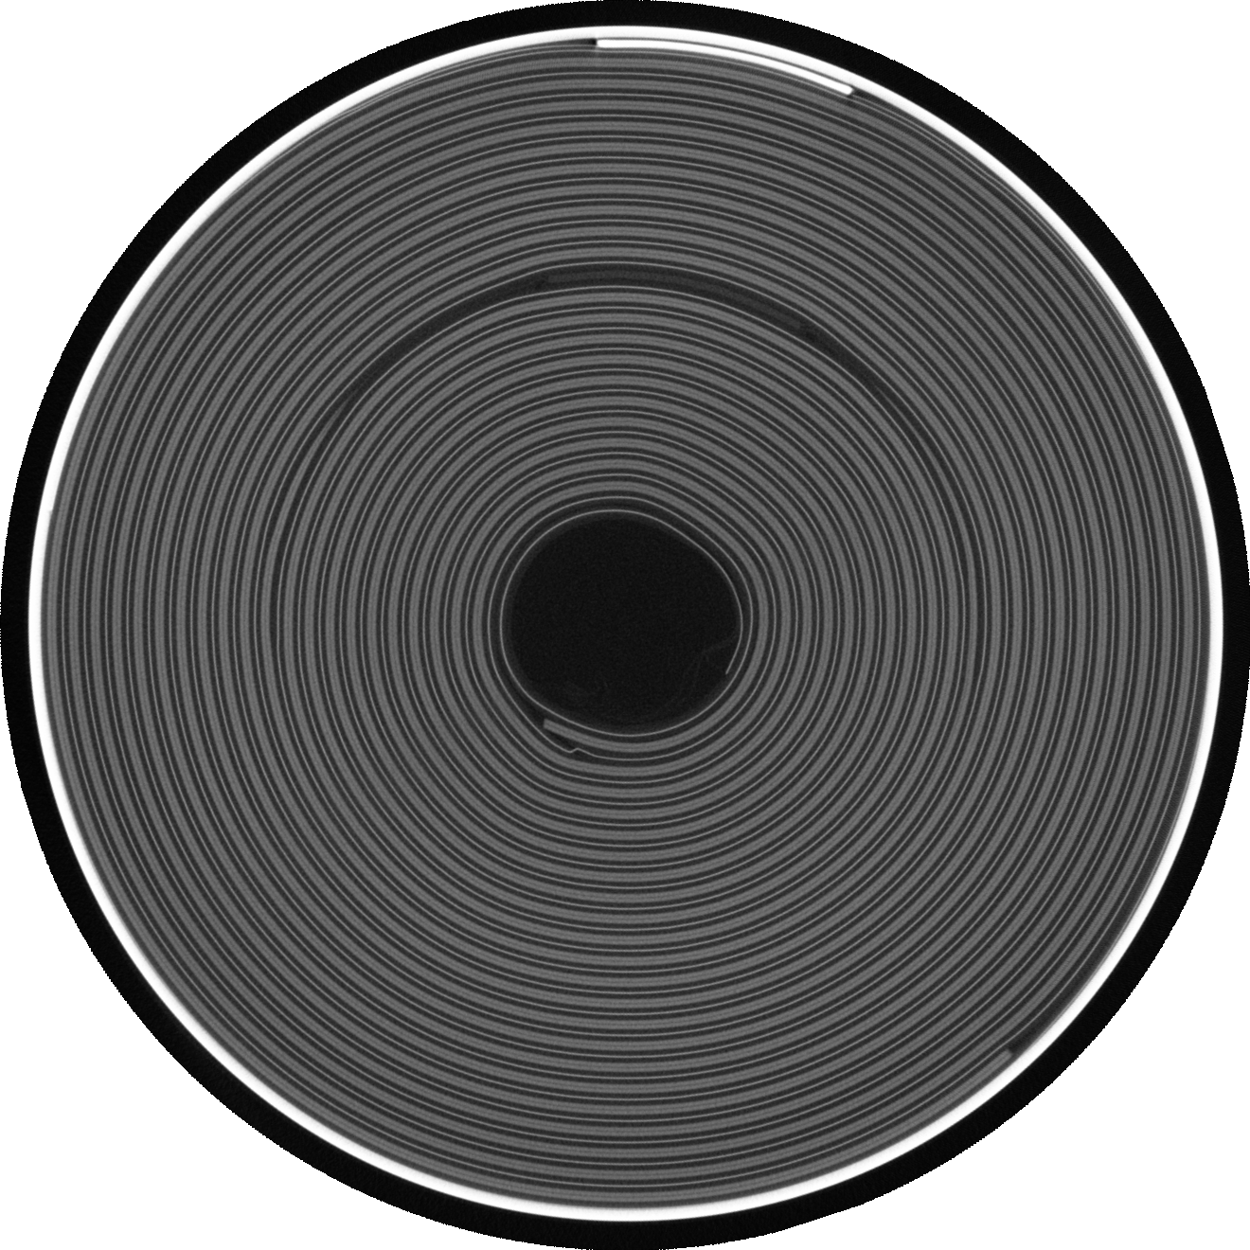
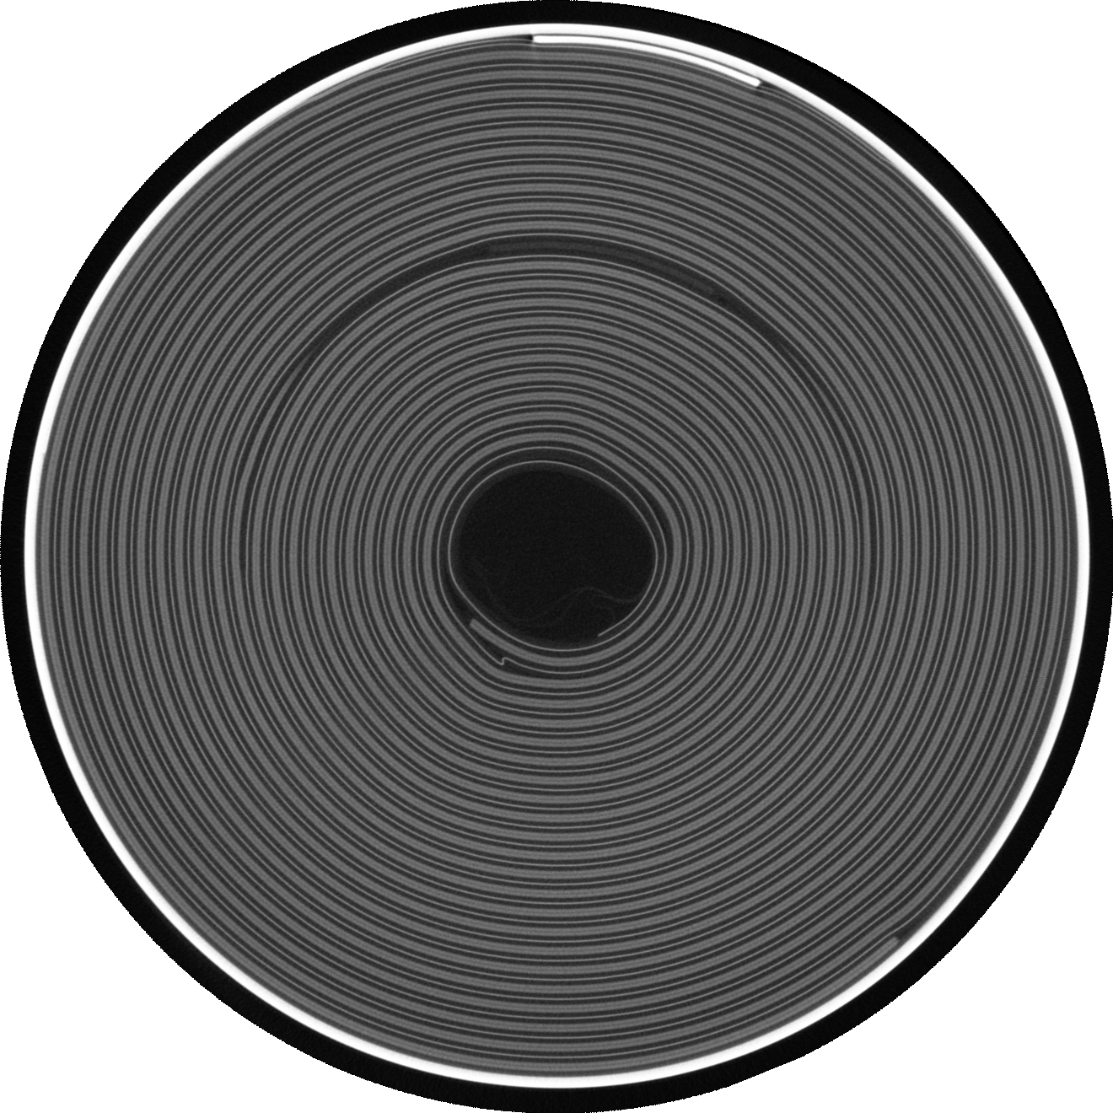


A
B
2 minutes exposure Before cycling
2 minutes exposure after 300 cycling
C
D
1 Hour exposure Before cycling
1 Hour exposure after 300 cycling

Slide 2
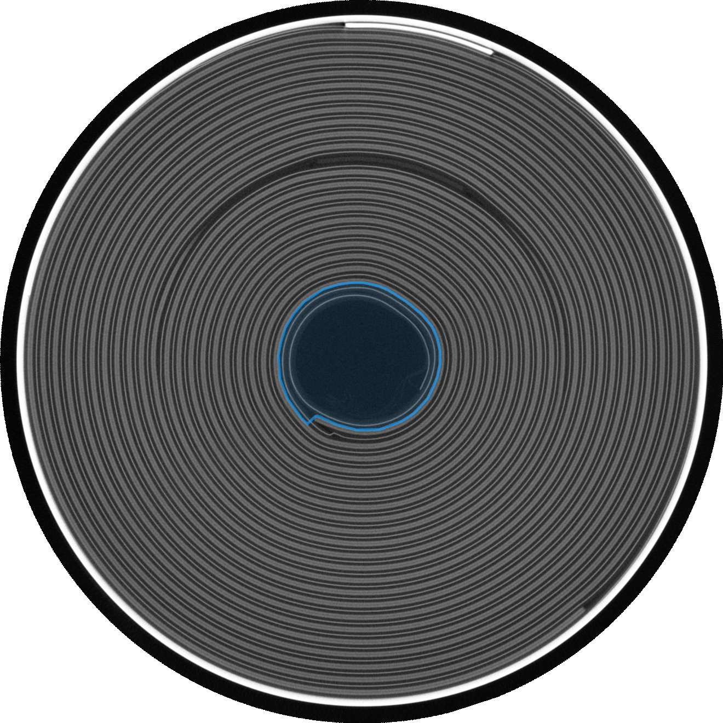
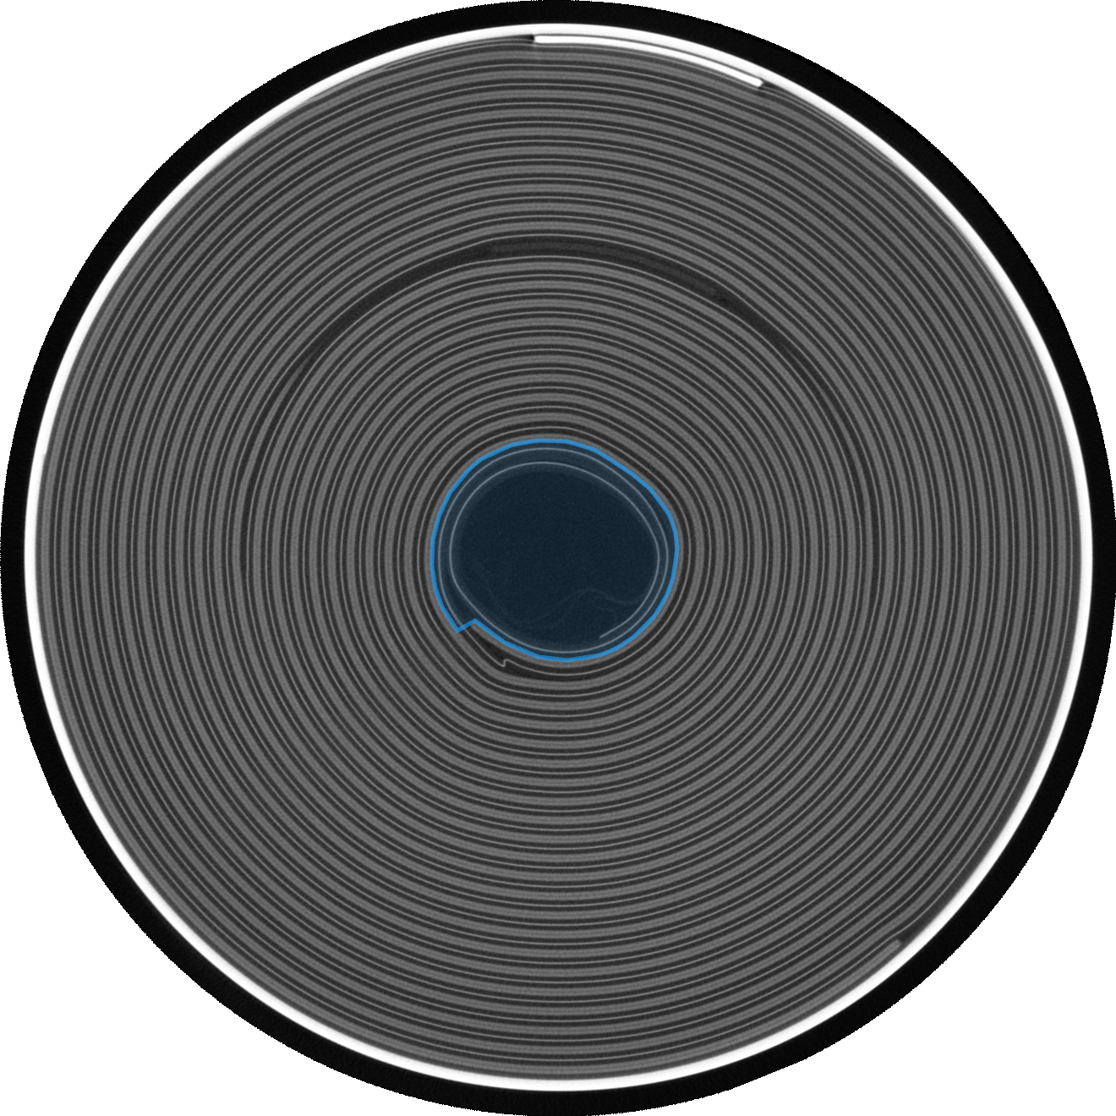


A
B
2 minutes exposure Before cycling
2 minutes exposure after 300 cycling
C
D
1 Hour exposure Before cycling
1 Hour exposure after 300 cycling

